Slide 1
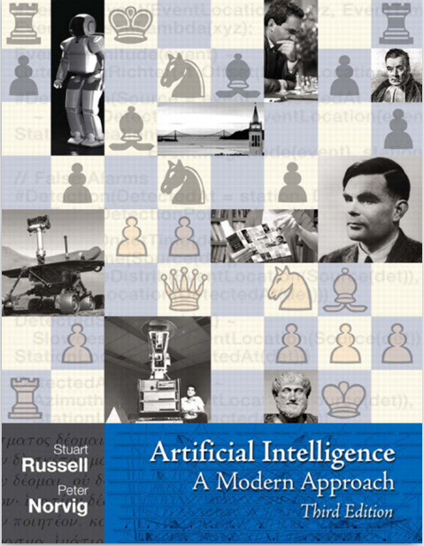

Slide 3
Agent Based Models
Definition of Agent
An agent is anything that can be viewed as perceiving its environment through sensors and acting upon that environment through actuators. This simple idea is illustrated in the next slide.
A human agent has eyes, ears, and other organs for sensors and hands, legs, vocal tract, and so on for actuators. A robotic agent might have cameras and infrared range finders for sensors

Slide 4
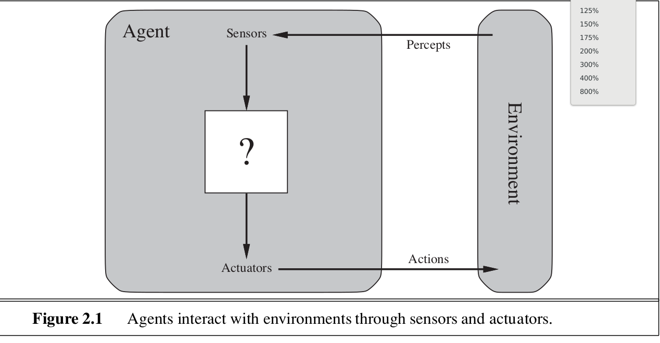
Agents Interact with the Environment

Slide 5
Definitions
Percept = The agent perceptual input at a given time
Percept Sequence = The complete history of events the agents has perceived.
Agent Function = A function that maps any Percept Sequence to an action

Slide 6
Agents
<number>
An agent is anything that can be viewed as perceiving its environment through sensors and acting upon that environment through actuators
Human agent:
eyes, ears, and other organs for sensors;
hands, legs, mouth, and other body parts for actuators
Robotic agent:
cameras and infrared range finders for sensors
various motors for actuators
Artificial Intelligence a modern approach

Slide 7
Agents
An agent is anything that can be viewed as perceiving its environment through sensors and acting upon that environment through actuators
Human agent:
eyes, ears, and other organs for sensors;
hands, legs, mouth, and other body parts for actuators
Robotic agent:
cameras and infrared range finders for sensors
various motors for actuators

Slide 8
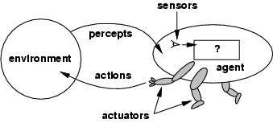
Agents and Environments
The agent function maps from percept histories to actions:
[f: P* → A]
The agent program runs on the physical architecture to produce f
agent = architecture + program

Slide 9
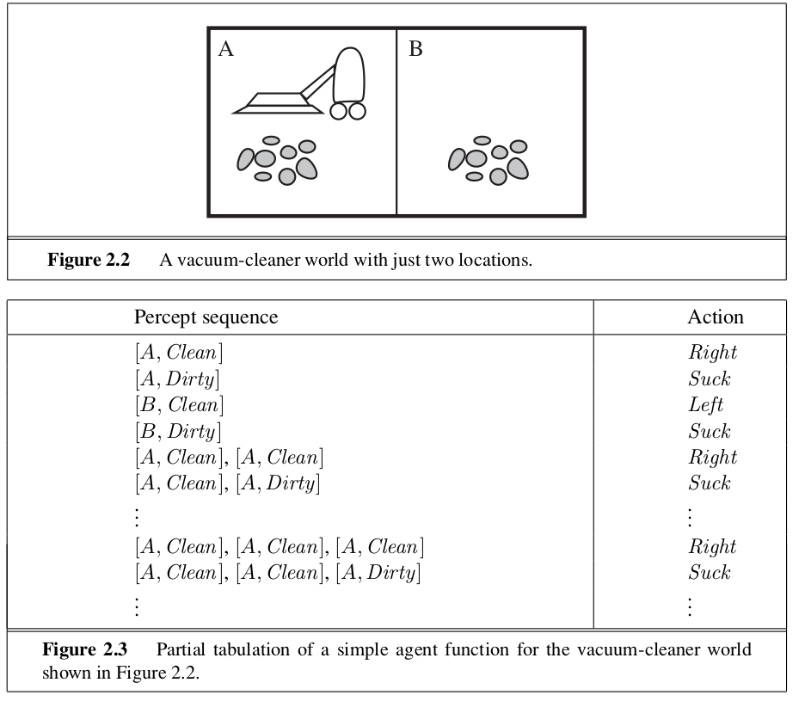

Slide 10
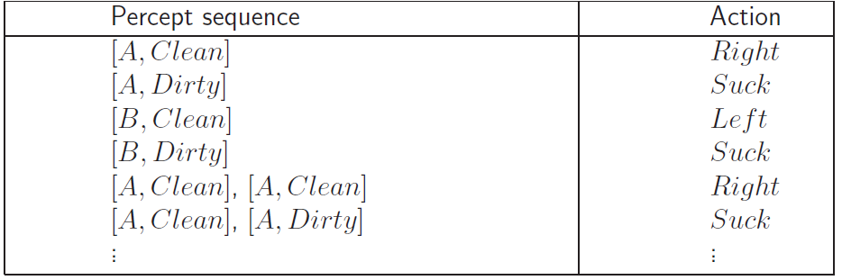
Vacuum Cleaner
Percepts: location and contents, e.g., [A,Dirty]
Actions: Left, Right, Suck, NoOp
Agent’s function → look-up table
For many agents this is a very large table

Slide 11
You can find the .ipynb file for this demonstration
in the module Agent Based Models
Does not seem to work in the datahub
But works in anaconda installation of Jupyter

Slide 12
Rational Agents
Rationality
Performance measuring success
Agents prior knowledge of environment
Actions that agent can perform
Agent’s percept sequence to date
Rational Agent: For each possible percept sequence, a rational agent should select an action that is expected to maximize its performance measure, given the evidence provided by the percept sequence and whatever built-in knowledge the agent has.

Slide 13
Rationality
Rational is different from omniscience
Percepts may not supply all relevant information
E.g., in card game, don’t know cards of others.
Rational is different from being perfect
Rationality maximizes expected outcome while perfection maximizes actual outcome.

Slide 14
Autonomy
The autonomy of an agent is the extent to which its
behaviour is determined by its own experience,
rather than knowledge of designer.

Slide 15
Learning From Experience (This is difficult)
Extremes
No autonomy – ignores environment/data
Complete autonomy – must act randomly/no program
Example: baby learning to crawl
Ideal: design agents to have some autonomy
Possibly become more autonomous with experience

Slide 16
PEAS
PEAS: Performance measure, Environment, Actuators, Sensors
Must first specify the setting for intelligent agent design
Consider, e.g., the task of designing an automated taxi driver:
Performance measure: Safe, fast, legal, comfortable trip, maximize profits
Environment: Roads, other traffic, pedestrians, customers
Actuators: Steering wheel, accelerator, brake, signal, horn
Sensors: Cameras, sonar, speedometer, GPS, odometer, engine sensors, keyboard

Slide 17
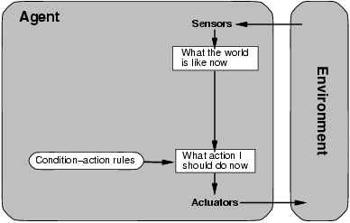
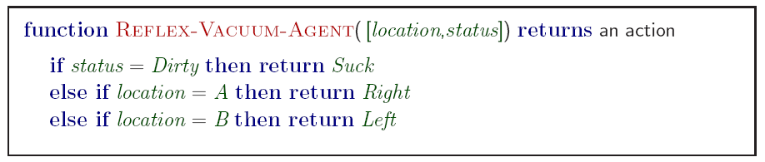
Simple reflex agents
<number>
Artificial Intelligence a modern approach
Notes:
Based on sensors
<number>

Slide 18
States: Beyond Reflexes
<number>
Recall the agent function that maps from percept histories to actions:
[f: P* → A]
An agent program can implement an agent function by maintaining an internal state.
The internal state can contain information about the state of the external environment.
The state depends on the history of percepts and on the history of actions taken:
[f: P*, A*→ S →A] where S is the set of states.
If each internal state includes all information relevant to information making, the state space is Markovian.
Artificial Intelligence a modern approach

Slide 19
Goal-based agents
<number>
knowing state and environment? Enough?
Taxi can go left, right, straight
Have a goal
A destination to get to
Uses knowledge about a goal to guide its actions
E.g., Search, planning
Artificial Intelligence a modern approach

Slide 20
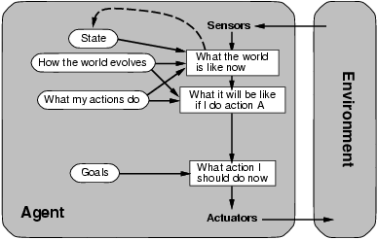
Goal-based agents
<number>
Reflex agent breaks when it sees brake lights. Goal based agent reasons
Brake light -> car in front is stopping -> I should stop -> I should use brake
Artificial Intelligence a modern approach

Slide 21
Utility-based agents
<number>
Goals are not always enough
Many action sequences get taxi to destination
Consider other things. How fast, how safe…..
A utility function maps a state onto a real number which describes the associated degree of “happiness”, “goodness”, “success”.
Where does the utility measure come from?
Economics: money.
Biology: number of offspring.
Your life?
Artificial Intelligence a modern approach
Notes:
Example: why is it important to get a good grade in this course?
<number>

Slide 22
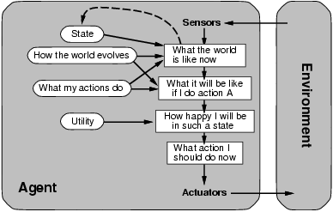
Utility-based agents
<number>
Artificial Intelligence a modern approach

Slide 23
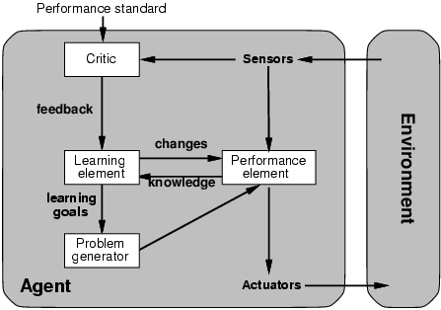
Learning agents
<number>
Performance element is what was previously the whole agent
Input sensor
Output action
Learning element
Modifies performance element.
Artificial Intelligence a modern approach
Notes:
Problem generator: acts in new ways, explores.
<number>

Slide 24
Summary
<number>
Agents can be described by their PEAS.
Environments can be described by several key properties: 64 Environment Types.
A rational agent maximizes the performance measure for their PEAS.
The performance measure depends on the agent function.
The agent program implements the agent function.
3 main architectures for agent programs.
In this course we will look at some of the common and useful combinations of environment/agent architecture.
Artificial Intelligence a modern approach

Slide 25

Source:
Wikipedia user LucasVB,
https://commons.wikimedia.or
g/wiki/File:Gospers_glider_gun
.gif
Conway’s Game of Life
12

